Slide 1

NASI SPONSORZY I PARTNERZY

Slide 2

Extended Events The Next Generation of Tracing for SQL Server
Bob Ward
Principal Architect
Microsoft Corporation
bobward@Microsoft.com

Slide 3
What we will cover today
Monitor
Troubleshoot
Learn
Debug
Extended Events (XEvent) Explained
Why XEvent?
XEvent Objects Explained
How do the components work?
XEvent Scenarios
Tracing performance on a live server
Tracking tempdb usage
Tracking a memory leak
Looking at system_health
Advanced Debugging: Hot spinlocks
Bonus: More XEvent
XEvent Tuning
Developing for XEvent
SQL Server 2014

Slide 4
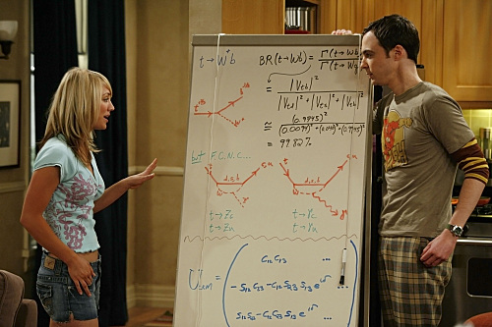
Extended Events Explained

Slide 5
Why XEvent?
SQLTrace and SQLProfiler are deprecated
Faster and scalable
Designed not to cause server problems
More events than SQLTrace ever had
Targets and actions make it powerful
SSMS includes the basic UI tooling

Slide 6
XEvent Objects Explained
Event
Actions
Predicates
Targets
Maps
Predefined instrumentation points in the code.
Event independent data to add to the collection
Independent fields for filtering
XEvent data storage (some are “smart”)
Ex. Event_file is basic file storage, histogram = “smart”
maps “codes” to meaningful names
Ex. wait_type
763 in SQL 2014
Ex. sql_text, create_dump_all_threads
Ex. database_id, session_id
SQLTrace Parity+
Notes:
5 mins
DEMO1: Show quickly how to find Xevent objects using sys.dm_xe_objects and sys.dm_xe_object_columns
I’m going to show you some of the various types of these objects (but not all) using practical troubleshooting scenarios including different events and targets

Slide 7
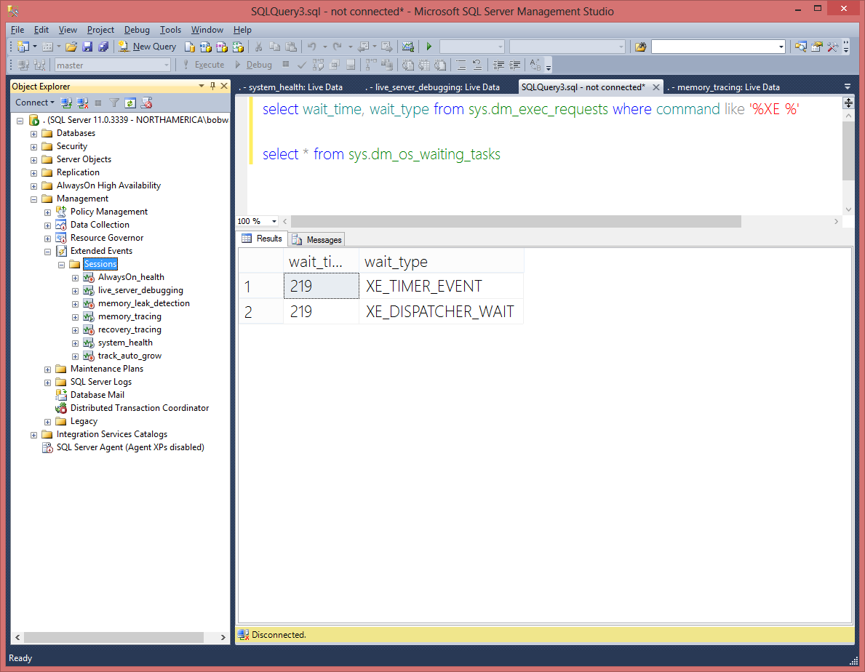
Extended Events Architecture
XEvent session metadata storage
CREATE EVENT SESSION
master
“Fire event in code”
1. Is enabled in a session?
2. Evaluate predicates
3. Fire Actions
ALTER EVENT SESSION…
STATE = START
DMVs
sync
Counter target
Event Session 1
Event Session 1 Buffer(s)
XE_TIMER
XEvent object catalog
File Target
FLUSH BUFFER
XE_DISPATCHER
async
Event Session 2
Event Session 2 Buffer(s)
Ring Buffer Target
View
target
data
Additional dispatchers
based on load
XEvent Engine – SQLDK.DLL
Notes:
5 mins
Mention XEvent is also implemented outside the engine in a DLL (XE.DLL) and is used by SSRS and Replication agents.

Slide 8
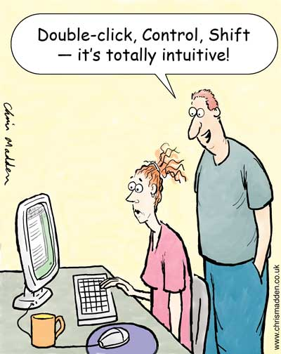
Extended Events Scenarios

Slide 9
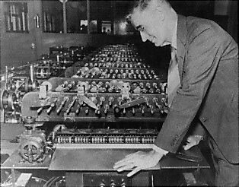
Tracing the Performance of a Live Server
What happens when a performance problem starts?
I want to avoid heavy data collection
I can’t use SQLTrace live
I don’t want to wait afterwards
Perfmon and DVMs help but….
There are limits and I want to know NOW!
XEvent provides streaming target
Low overhead and available through SSMS
SSMS has new “SQLProfiler”
Grid Results, Grouping, Aggregation, and Filtering
Merge and Export to Excel
Can read any XEL file or streaming target
Adds new event_stream target dynamically
Notes:
10 mins
DEMO2: Tracing a live server performance problem. Also show merge and export feature as part of this.

Slide 10
Query Hashing
Select * from sys.objects where object_id = 5
Sql_handle | Plan_handle | Query_hash | Query_plan_hash
0x020000006BC14A082C73C2F5D446A1A3742C811A978F419F | 0x060001006BC14A0840418083000000000000000000000000 | 0x8CF39B917B49F822 | 0x65C3D34DFB208D74
Select * from sys.objects where object_id = 34
Sql_handle | Plan_handle | Query_hash | Query_plan_hash
0x020000006BC14A082C73C2F5D446A1A3742C811A978F419F | 0x060001006BC14A0840418083000000000000000000000000 | 0x8CF39B917B49F822 | 0x65C3D34DFB208D74
0x020000000B93242E7B107E201EC2C39612AFB105C1B82D50 | 0x060001000B93242E40E15883000000000000000000000000 | 0x8CF39B917B49F822 | 0x65C3D34DFB208D74
Notes:
Query_plan_hash can be helpful to compare plans for same query_hash over time.

Slide 11
Inaccurate Cardinality Estimation
Event raised if output for operator is significantly > than estimate
Fires as the operators are executed
Based on algorithm of exponential differences
Running this all the time can have an impact on query performance
We can tune algorithm with DBCC OPTIMIZER_WHATIF (UNDOC’D)

Slide 12
Who is Using Tempdb?
Tempdb is the dumping ground for the engine
User data and “internal” data
Internal includes sort spills, worktable, workfiles, and version store
How do you track usage?
sys.dm_db_file_space_usage – user and internal usage per file
sys.dm_db_session_space_usage – user and internal usage for an active session
How do you know what is using tempdb?
XEvent brings a new story
allocation_ring_buffer_recorded event
Trace flag 1106
All of the “ring buffer” entries are also events
Notes:
5 mins
DEMO3: Using trace flag 1106 and XEvent to show the top tempdb space usage consumers.

Slide 13
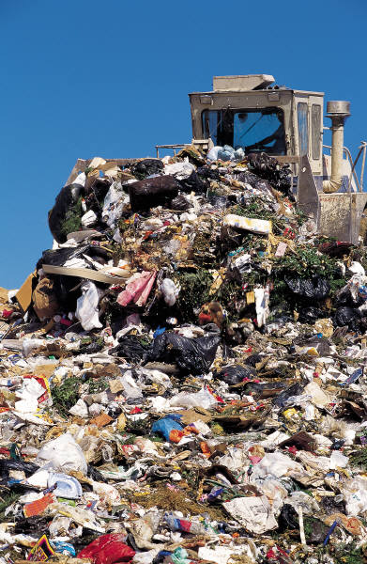
The Tempdb Dumping Ground
User objects
Temporary tables
Table variables
User defined objects
Internal objects
Sorts
Work tables
Workfiles
TVF return values
Table valued parameters
Temporary procedures
Version store
Explicit T-SQL command
Implicit T-SQL command
Inside Tempdb on PASS TV
Blog Edits

Slide 14

Finding a Memory Leak
Memory leaks can have many symptoms
Msg 701 – OOM error and ERRORLOG “dump”
High CPU (Resource Monitor)
Slow performance
Clerks and Objects are the key
Find clerks that “should not keep growing” (this is where)
sys.dm_os_memory_clerks
sys.dm_os_memory_objects (Most leaks are memory objects)
sys.dm_os_memory_allocations
How do you know who and what is causing it?
XEvent simplifies the mystery
page_allocated and page_freed events
event_pairing target
Notes:
10 mins
DEMO4: Tracing a memory leak with XEvent and event_pairing target. Be sure to note that watching live opens up a new target that is a stream of all events and does not use the pairing logic.

Slide 15

SQL Server 2012 Memory Changes
A single unified memory model
No single vs multi-page allocators
SQLOS allocates all memory (BPool now a consumer)
DMVs and DBCC MEMORYSTATUS affected
“max server memory” means….. “max server memory”
Resource Governor applies to multi-page allocations
Watch out for These
No AWE support for 32bit
“MemToLeave” for 32bit changed
Trace flag 845 for “locked pages” on Standard SKU no longer required
SQL Server 2012 SP1 regression – page life expectancy can drop severely
SQL Server 2012, “away buffers”, sorts, and non-yielding problems.
Performance Problems with SQL Server 2012 Enterprise Edition Under CAL Licensing
SQL Server 2012 Users: Apply latest CU

Slide 16
The System Health Session
system_health session introduced in SQL Server 2008
A “pre-built” session Designed by CSS
Installed by default and run at server startup
Includes high sev errors, deadlocks, waits, spinlock backoffs
SQL Server 2012 introduces sp_server_diagnostics
Aggregated health statistics about the engine
Background thread every 5 minutes and produces event
system_health now includes sp_server_diagnostics event
SQL Server Instance Failover and AlwaysOn use for failover decisions
system_health is new default “health log”
Now writes to file target (5MB with 4 rollover files)
Not sure what happened to your server?....look at this first.
Notes:
5 mins
DEMO6

Slide 17

How does sp_server_diagnostics work?
sp_server_diagnostics
SQLSERVR.EXE
T-SQL repeat=30% of health timeout
TDS App
repeat interval
Background System Task
sp_server_diagnostics code
repeat=5min
sp_server_diagnostics code
Engine
Code
Cluster failover resource DLL
Server scoped and pre-emptive
Internal XEvent Session with callbacks
.XEL file
system_health XEvent session
sp_server_diagnostics_component_result
Event

Slide 18
Advanced Debugging: Hot spinlocks
XEvent can help pinpoint what and who
spinlock_backoff event
Histogram target
to group what and who
Spinlocks protect shared memory structures
We “spin” or loop using CPU while waiting for access
These should be very short waits
If “not working optimally” high CPU can occur.
But…if long time we “sleep” or “backoff” and spin again.
What if you have high CPU for SQL but one query doesn’t appear to be the problem?
Could be a “hot” spinlock
Check sys.dm_os_spinlock_stats
Look for high #collisions, spins per collisions and especially high #backoffs.
Now you know “what” but don’t know “who”
Avoid SOS_*
Notes:
DEMO Note: Requires SQL Server 2012 SP1 CUI8 or earlier. CU9 has a fix for this.

Slide 19
A look at this problem visually
Lock hash
buckets
Resource=DATABASE:7
……………………..
User1
User2
User3
User4
User 10000
New user for dbid=7 requires spinlock and a long list traveral
Fix is to partition this lock resource by CPU. List shorter and only one user runs on scheduler at a time anyway
User1
User2
User3
User4
User
1000
User
1001
User
10000
User
10001
CPU0
CPU1
CPU2
CPU3

Slide 20
References
Extended Events CSS Wiki
SQLSkills (Jonathan Kehayias) blog posts on XEvents
Memory manager changes in SQL Server 2012 blog post
XEvent blog posts on CSS Escalation blog
Extended Events blog (older but still relevant)

Slide 21
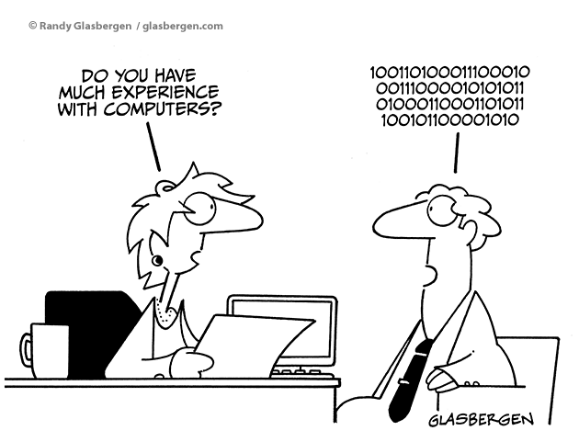
BONUS: MORE XEvent

Slide 22
XEvent Tuning
Why is XEvent scalable?
Optimized code with little overhead
Buffers can be partitioned by NODE or CPU
Asynchronous processing and dispatching of events with worker pool
Event Loss, memory, and dispatch latency
Event loss policy tradeoff of data loss vs server impact (Default = ALLOW_SINGLE_EVENT_LOSS)
MAX_MEMORY may help for heavy or large trace loads (XE_BUFFERMGR_FREEBUF_EVENT waits)
Lowering latency allows you to “see” events faster but at penalty of more frequent flushes
sys.dm_xe_sessions gives you stats on memory, loss, and blocking
Capabilities and customizable fields
ETW and event_counter are synchronous targets (could cause blocking)
Some objects are “private” (Ex. Server auditing uses XEvent)
Some events cannot be used in NO_EVENT_LOSS session (“no_block”) (Ex. page_allocated)
Some fields are not collected by default and require customizable field (Ex. collect_path for file_read)

Slide 23
Developing for XEvent
XEvent Object Model
XEvent LINQ Provider
manage objects and sessions
Consume files and event_stream
read files and produce XML results
sys.fn_xe_file_target_read_file
Manage objects and sessions
PowerShell Provider for XEvent
Notes:
Object Model is part of SMO
LINQ provider installed with client tools as Microsoft.SqlServer.XEvent.Linq.dll
PS Provider part of SQL Server PowerShell provider

Slide 24
SQL Server 2014
wait_completed
query_optimizer_estimate_cardinality
dyn_throttle_checkpoint
xfcb_read_complete
buffer_pool_extension_pages_read
cgen
Includes wait_resource
Debug new CE model decisions
Track checkpoint throttling
XStore tracing
Buffer Pool SSD extension
Hekaton proc C code generation

Slide 25

NASI SPONSORZY I PARTNERZY
Organizacja: Polskie Stowarzyszenie Użytkowników SQL Server - PLSSUG

